Slide 1

WHISPER
OPEN AI
WHISPER
Presented by: Swostika Basukala
12th January

Slide 2
PRESENTATION OUTLINE:
WHISPER
INTRODUCTION TO THE MODEL
ARCHITECTURE
IMPLEMENTATION OF TRANSCRIPTION
IMPLEMENTATION OF TRANSLATION
SPEAKER DIARIZATION
TIME STAMP ALIGNMENT

Slide 3
INTRODUCTION TO WHISPER
WHISPER
General purpose,Sequence to Sequence, ASR and speech translation model
Utilizes a transformer-based encoder-decoder architecture
Support 99 languages
Release date:
September 2022 (original series), December 2022 (large-v2), and November 2023 (large-v3)
Training data:
Total dataset size is 680,000 hours.
Weakly supervised available in internet
About a third of the dataset of non-English languages and remaining of English language.

Slide 4
Contd...
WHISPER
Model details:
Parameter counts:
Tiny: 39 million
Base: 74 million
Small: 244 million
Medium: 769 million
Large: 1.5 billion
Model Capabilities:
Transcribes spoken audio into text
Translates speech from one language to another
Language Identification
Speaker Diarization
Speech-to-text alignment
Distinguishes between speech and non-speech segments in audio

Slide 5
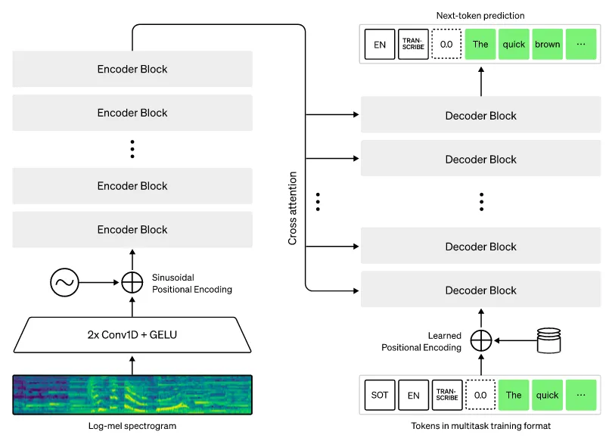
ARCHITECTURAL DETAIL:
WHISPER

Slide 6
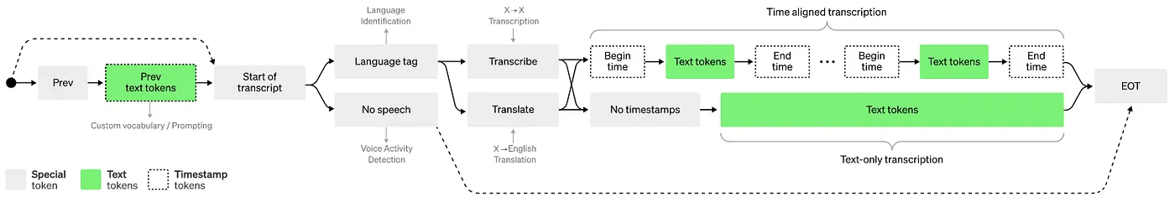
TOKENS IN MULTITASK TRAINING MODEL
WHISPER

Slide 7
OVERALL WORKFLOW
WHISPER
start
Compute time stamp
Input audio
Prepare for the next token
Mel-spectrogram conversion
End of token?
Perform Language detection
no
Convert feature vector to token
yes
End

Slide 8
MODEL COMPARISON
model | layers | Width | Heads | Learning rate(Max)
tiny | 4 | 384 | 6 | 1.5 × 10⁻³
base | 6 | 512 | 8 | 1 × 10⁻³
small | 12 | 768 | 12 | 5 × 10⁻⁴
medium | 24 | 1024 | 16 | 2.5 × 10⁻⁴
large | 32 | 1280 | 20 | 1.75 × 10⁻⁴

Slide 9
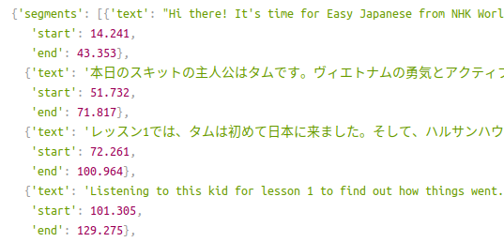

IMPLEMENTATION:Speech to text(Transcription)
WHISPER
Input audio
Output text

Slide 10
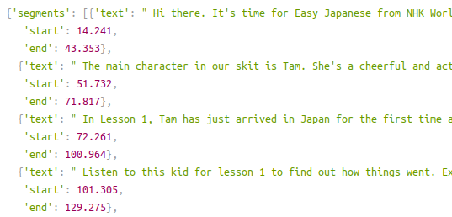
WHISPER
IMPLEMENTATION:Speech to text(Translation)

Slide 11
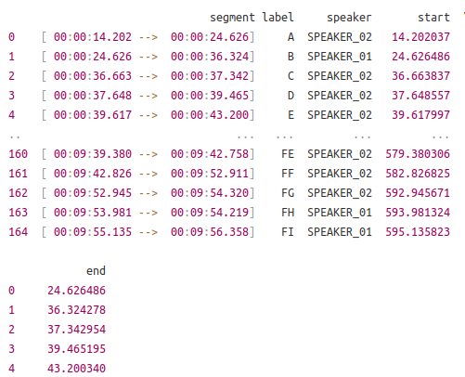
IMPLEMENTATION:Speaker diarization
WHISPER
segmentation
Speaker Embeddings
Clustering
Labeling
Speaker label

Slide 12
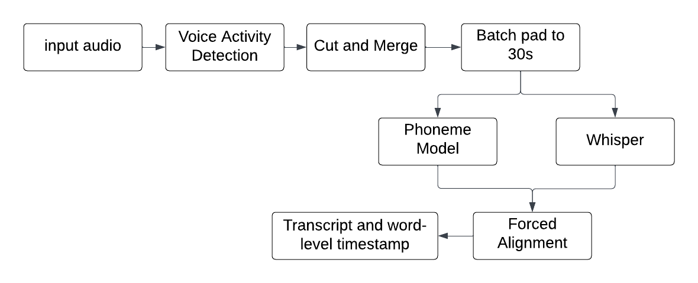
IMPLEMENTATION:(Word level timestamp)
WHISPER

Slide 13
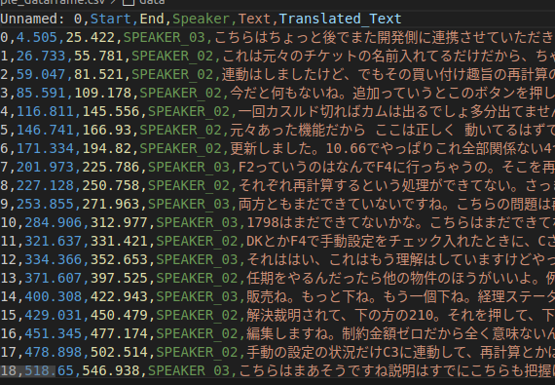
TEXT TO SPEECH (Seamless model)
WHISPER
Seamless model for text to speech translation

Slide 14
SPEECH TO TEXT(Bark)
WHISPER
"Hey everyone! I hope you're all doing well.
Thank you for attending our workshop."
Bark model for text to speech translation

Slide 15
REFERENCES
WHISPER
Whisper Model documentation
Medium (whisper model explaination)
whisper Github
Attention Is All You Need
WhisperX documentation

Slide 16
Thank you!
WHISPER
Presented by:
Swostika Basukala

